Slide 1

BASIC COMPUTER USAGE
CHAPTER 1
WORK
ON WINDOWS

Slide 2



NOTE TAKING
DURING THE CLASS
AFTER THE CLASS
QUICK NOTES
ON YOUR DRAFT NOTEBOOK
CLEAN NOTES
ON YOUR BCU NOTEBOOK

Slide 3

OBJECTIVES FOR TODAY
What is an Operating System ?
Use Windows basic features :
Desktop
Start menu
Task bar
Find, start an app
Move, minimize, maximize, close a window

Slide 4


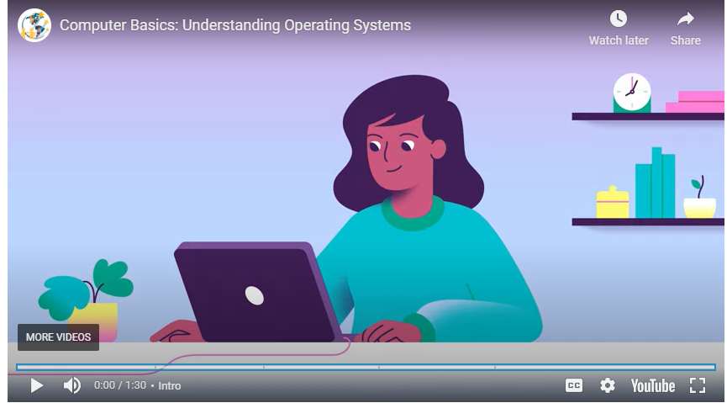
WATCH
What is an operating system ?
10 MIN
What this video 2 times
Take notes
Answer to the question
What is an Operating System?
https://edu.gcfglobal.org/en/computerbasics/understanding-operating-systems/1/
Notes:
Software is set of instructions that tells the hardware what to do and how to do it. Software includes Operating system (OS) and application.

Slide 5







EXPLAIN
What is an operating system ?
05 MIN
An operating system is a program that allows you to interact with your computer.
Screen
Printer
OS
Mouse
Keyboard
Applications
Notes:
Example to human, phone, and whatever.

Slide 6
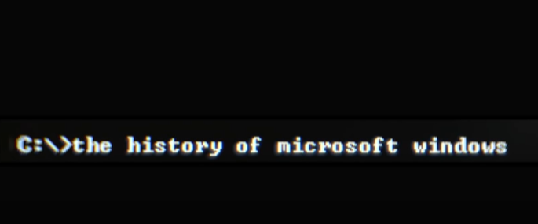
WATCH
History of Window OS
10 MIN
What this video 2 times
Take notes
Answer to the questions :
When was the first Windows OS created ?
Now which version of Window are we using ?
https://www.youtube.com/watch?v=hAJm6RYTIro&ab_channel=BloombergQuicktake%3AOriginals
Notes:
The first version of Windows was released on November 20, 1985

Slide 7
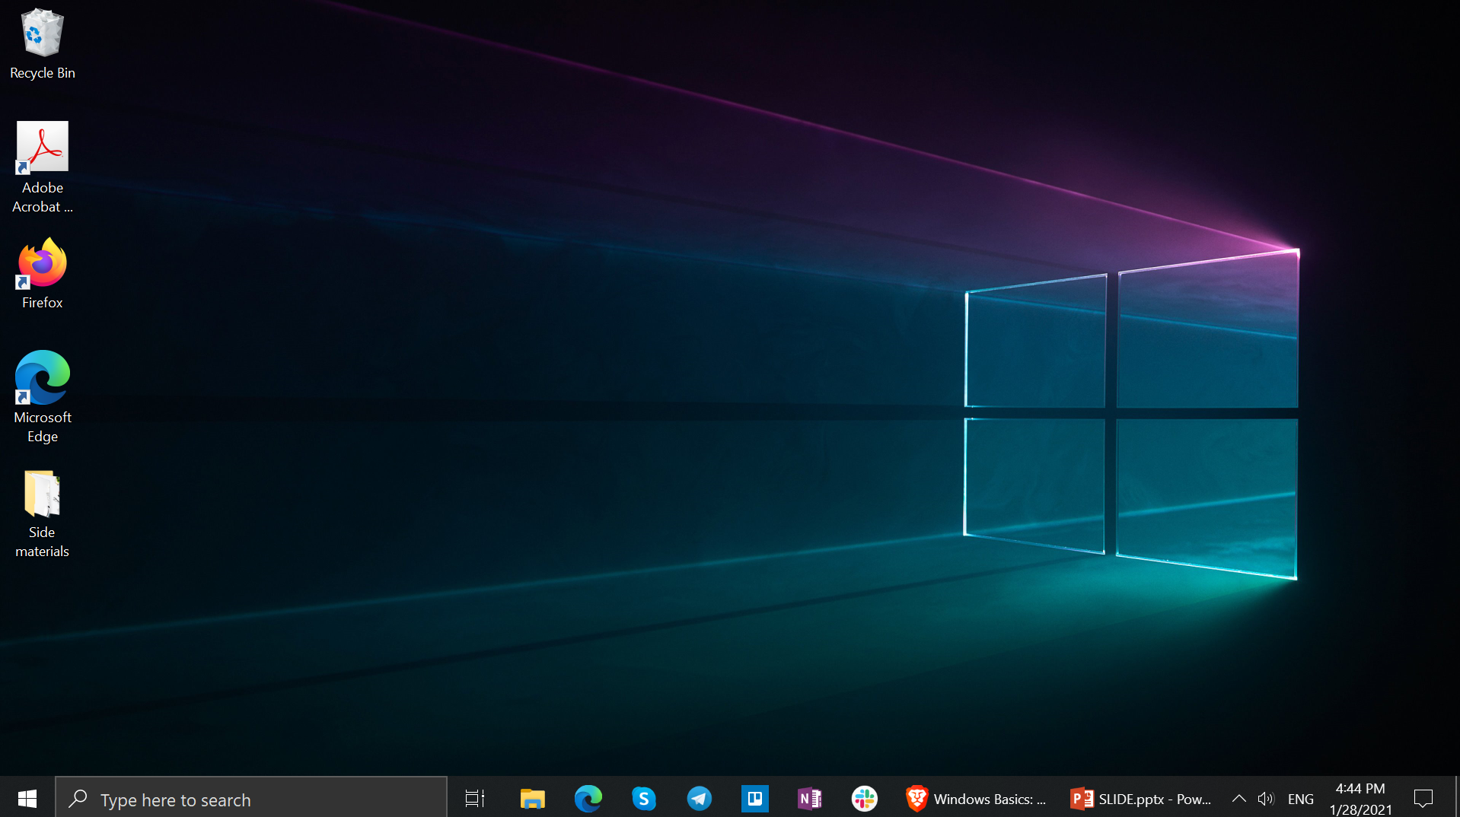
EXPLAIN
How to use Window desktop
05 MIN
Recycle Bin
Desktop Background
Application Icons
The Desktop
Folder on desktop
Start Menu
Taskbar

Slide 8
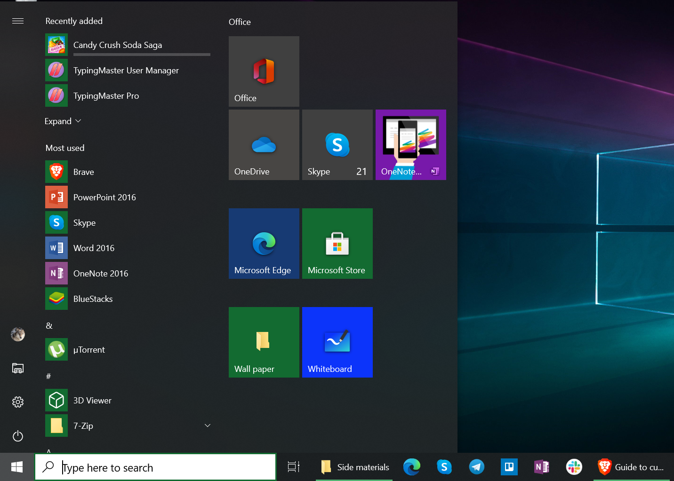
EXPLAIN
How to use Window start menu
05 MIN
Click here to start

Slide 9
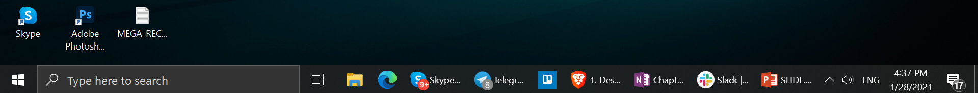
EXPLAIN
How to use Window task bar
05 MIN
The taskbar has many purposes
quick short cut, current running applications, search bar, notifications
Search Box
Pinned Applications
Notification Area
Start Menu
Task View

Slide 10

ACTIVITY
Configure your start menu and task bar
10 MIN
ON START MENU :
ON TASK BAR
Unpin all default pinned application
Unpin the search box from taskbar
Pin to Task bar:
Pin to Start Menu :
Chrome
Word
PowerPoint
Excel
Notepad
Calculator
Typing Master
File Explorer
Telegram
Paint

Slide 11
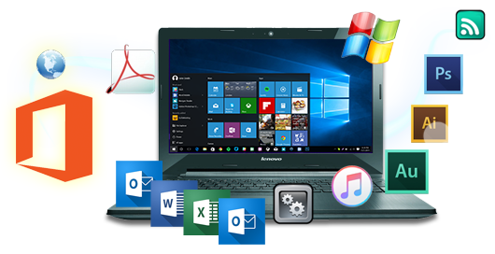
EXPLAIN
What is an application ?
05 MIN
An application is a software that allows you to complete tasks on your computer.

Slide 12
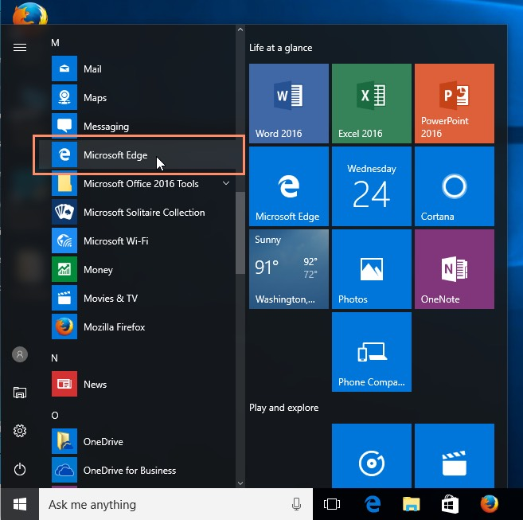
EXPLAIN
Open an application
05 MIN
1 – Find an application
Open the start menu
Scroll down or type the app name
2 – Open an application
On taskbar or start menu : simple click
On desktop double click
Search bar to find apps

Slide 13
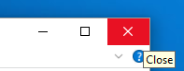
EXPLAIN
What is a window ?
05 MIN
When we open an application, this app appears in a new window
The 3 buttons of a window
3 buttons are always displayed:
Minimize
Maximize
Close
Try it !

Slide 14
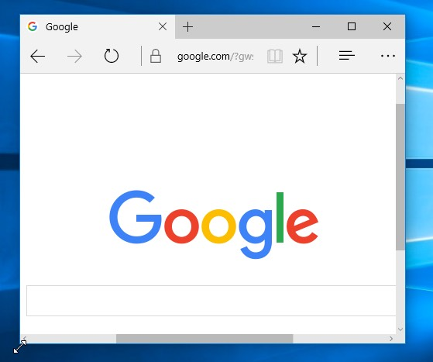
ACTIVITY
Working with Application
10 MIN
Click and drag on window header to move
Open Chrome
Move and resize Chrome windows
Maximize Chrome windows
Minimize Chrome windows
Close Chrome
Click and drag window edges to resize

Slide 15


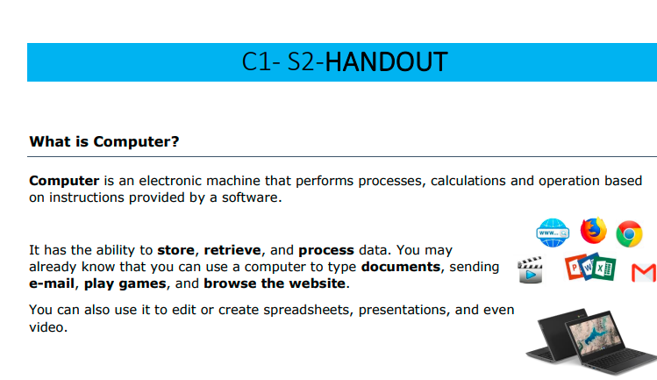
HOMEWORK
Howemork
Review the slides send by the teacher
Review your draft notes
Write clean notes on your BCU workbook
Read the handout
Answer the questions
DRAFT NOTES
BCU NOTEBOOK

